Slide 1


TRICKSTERS
TRICK OR TREAT

Slide 2
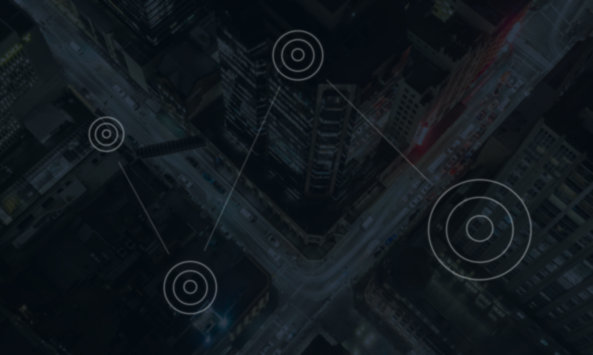
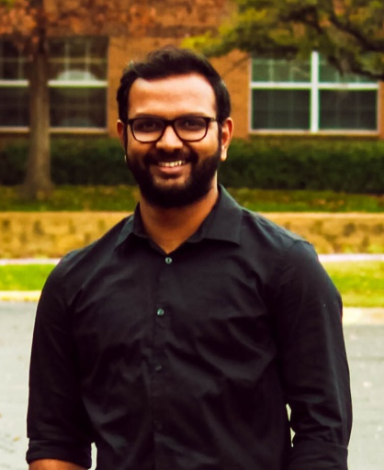
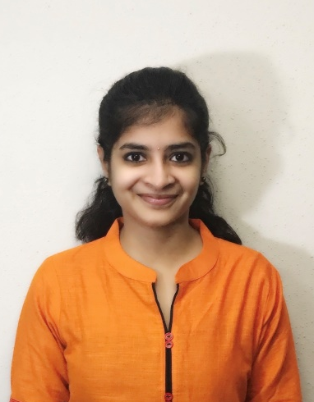
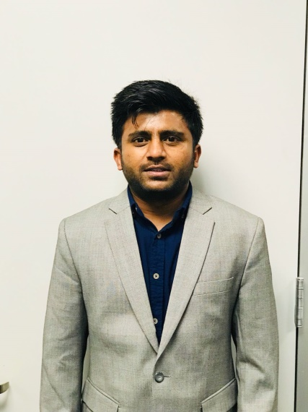
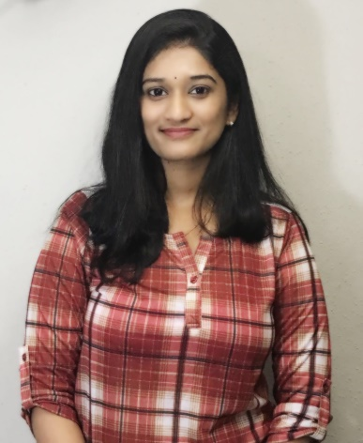
GAURAV KAMIREDDI
SOUMYA PERURI
Technical Lead
Presentation & Website Lead
Inquisitive, energetic computer science specialist skilled in leadership, with a strong foundation in math, logic, and cross-platform coding.
Attentive, straight forward, and enthusiastic learner. Interested in analyzing tasks and getting my hands on some experience.
MOHAN MURTHY
NIKITHA NAINI
Project Manager
Technical Report Lead
To build a challenging career with honesty and loyalty by translating my experience, knowledge, skills and abilities into value for an organization.
Good analytical skills and innovative problem-solving ability. Able to perform as an amicable team player. Excellent Leadership and programming skills.

Slide 3

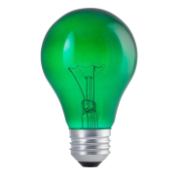
Smart LED Light Bluetooth Mesh Network
DR. KEWEI SHA
Associate Director of Cyber Security Institute and Assistant Professor of Computer Science at University of Houston - Clear Lake (UHCL).
MR. YIMING YANG
Mentor from CMVision Technologies Inc., who gave us the opportunity to work on bluetooth technology.

Slide 4
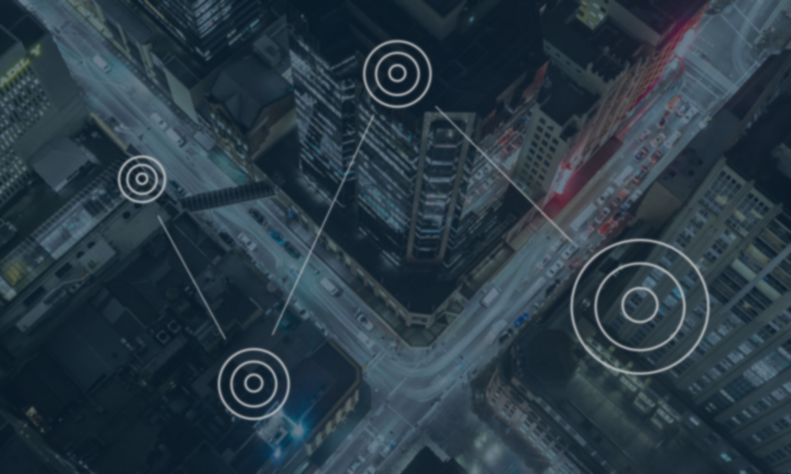
INTRODUCTION | REQUIREMENTS | ARCHITECTURE DESIGN | WEB UI
IMPLEMENTATION & DEMO | AGENDA |  | TIMELINE
CHALLENGES | FUTURE | CONCLUSION | REFERENCES

Slide 5


INTRODUCTION
Smart LED Light Bluetooth Mesh Network using Bluetooth Low Energy (BLE) 4.0 channel available on Raspberry Pi 3 module.
Creating the mesh topology using self organized algorithm for the lights.
Web User Interface that displays Mesh topology and allows to view the status and perform operations.

Slide 6

BACKGROUND
Back-end Development
Node JS
Packages: Bleno (Advertise), Noble (Scan)
Server-end Development
Node JS
Express JS
Front-end Development
HTML5
CSS3
Angular JS
Frameworks: Vis JS

Slide 7





REQUIREMENTS
Web UI should be able to create and display Mesh Topology.
Smart LED Light should inquire and get connected.
Web Server should be able to send the inquire request to the Bluetooth nodes in the mesh
Web UI should be able to send inquire and receive response.
Raspberry Pi 3 module with Bluetooth feature is needed.

Slide 8
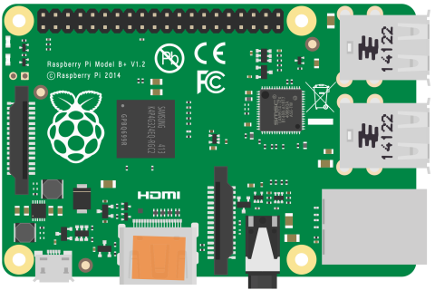


ARCHITECTURE DESIGN
Raspberry Pi 3 - 1
Web UI
Raspberry Pi 3
Name : Raspberry Pi3/BLE010V5
UUID : EE:52:5B:04:00:02
RSSI : 93db
(Received Signal Strength Indication)
Raspberry Pi 3 - 2

Slide 9
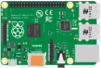
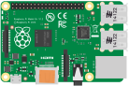
THE MESH
[UUID2]
PiMesh1 UUID0
[UUID0], [UUID3]
[UUID0], [UUID0]
PiMesh3 UUID2
Pi 3 UUID
[UUID2]
PiMesh4 UUID3
PiMesh2 UUID1

Slide 10

WEB USER INTERFACE

Slide 11

BLU MESH
DISCOVER
DASHBOARD
LIGHTS
SETTINGS
The first rule of any technology used in a business is that automation applied to an efficient operation will magnify the efficiency. The second is that automation applied to an inefficient operation will magnify the inefficiency.

Slide 12

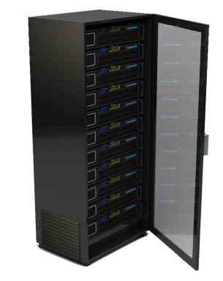
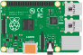
BLU MESH
DISCOVER
DASHBOARD
LIGHTS
SETTINGS

Slide 13
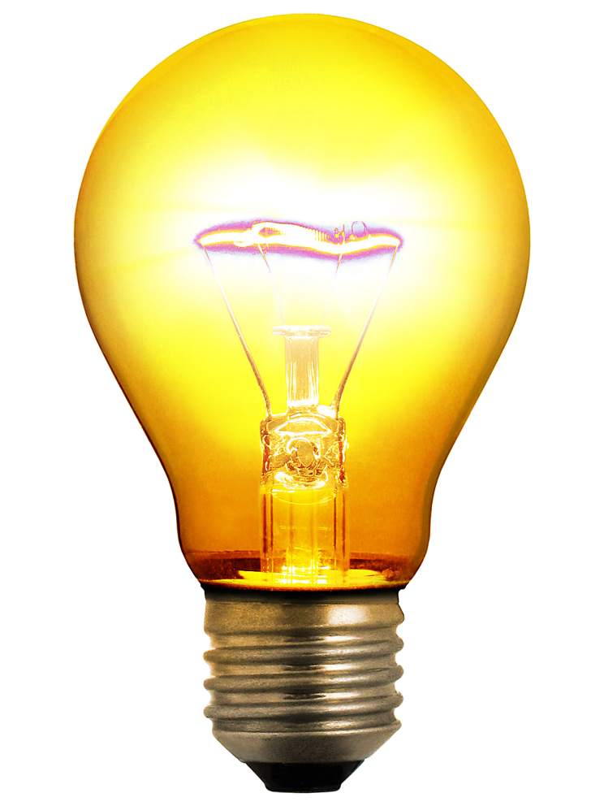
BLU MESH
DISCOVER
DASHBOARD
LIGHTS
SETTINGS
SWITCH
ON
OFF
NAME
Pi Mesh 1
UUID
B0:B4:48:BF:C9:84
MESH LIST
[Pi Mesh 2,
Pi Mesh 3,
Pi Mesh 4]

Slide 14



IMPLEMENTATION

Slide 15
VISUAL DEMO

Slide 16





TIMELINE
MAY 04
APRIL 24
Final Demonstration
Final demonstration of the Smart LED Bluetooth Mesh Network.
APRIL 17
Poster Presentation
Poster presentation which involves complete project documentation in one single page.
MARCH 13
Prototype Demonstration
Complete walkthrough of the project with Raspberry Pi 3 and CSR module from the Web User Interface.
FEBRUARY 20
Web User Interface
Design of the Web User Interface to connect with the Raspberry Pi 3 server and the CSR mesh topology.
Raspberry Pi 3 Connection
Connected Raspberry Pi 3 as a Web Server and able to send and receive messages with the server.

Slide 17
RESPONSIBILITIES
Web Application Development
Soumya | Nikitha
Mesh Topology
Mohan | Nikitha
Setting up Raspberry Pi 3
Soumya | Nikitha
Programming CSR
Mohan | Pratik
Server Side Development
Mohan | Pratik | Soumya | Nikitha
Report Documentation
Soumya | Pratik
Presentations
Soumya | Pratik

Slide 18

CHALLENGES
Displaying dynamic view of mesh network in Web UI.
Managing flooding technique to deliver messages efficiently.
Developing industrial standards Web UI with node interactions where the nodes acting as CSR1010 modules.

Slide 19
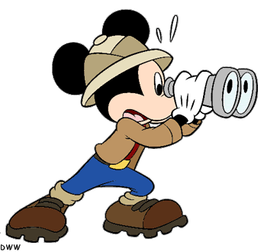
FUTURE
Grouping two or more lights and be able to control them.
Adding motion sensor hardware features and applying them to switch on the lights automatically.
Changing intensity of the light to control power consumption.
Adding color changing facilities.
Scheduling the light to switch on for a particular duration.

Slide 20

CONCLUSION
We are successfully able to communicate with the CSR1010 device from the Webserver (Raspberry Pi 3).
We successfully designed the Mesh Network for the given nodes.
We are able to extend the nodes for the existing network.
We have made the Web UI more flexible and user friendly.

Slide 21

REFERENCES
http://eeca2.sogang.ac.kr/publications/international/BLEmesh_A%20Wireless%20Mesh%20Network%20Protocol%20for%20Bluetooth%20Low%20Energy%20Devices.pdf
file:///C:/Users/soumy/Downloads/csr101x-product-brief%20(1).pdf
https://blog.bluetooth.com/introducing-bluetooth-mesh-networking
https://developer.qualcomm.com/hardware/csr101x/qc-ble-starter-development-kit

Slide 22
SO
ANY
QUESTIONS?

Slide 23
connect
Thank you
inspire

